Slide 1
RentCar
Pengembangan Aplikasi Perangkat Bergerak B

Slide 2
Our team
Ahmad Iqbal Fadhillah
Arya Candra
Rifaldho Muhammad Rizki
11191004
11191012
11191063

Slide 3
Apa itu RentCar?
RentCar adalah sebuah aplikasi yang melayani jasa sewa mobil di daerah Balikpapan. Pelanggan dapat memilih jenis mobil yang nyaman digunakan, baik dengan sopir ataupun hendak rental mobil lepas kunci dengan waktu sewa yang fleksibel.

Slide 4
Kebutuhan Perangkat Lunak

Slide 5
Functional Requirement
ID | Kebutuhan Fungsional | Penjelasan | Aktor
FR-01 | Login | User dapat mengakses aplikasi menggunakan akun | User
FR-02 | Register | User dapat mendaftar untuk mendapatkan akun | User
FR-03 | Home/Laman Rental | User dapat melihat tampilan utama aplikasi dan dapat melihat pilihan mobil yang dapat dirental | User
FR-04 | Akun | User dapat melihat dan mengedit profil user | User
FR-05 | Booking | User dapat memesan mobil pilihan dan terhubung ke kontak kantor rental | User

Slide 6
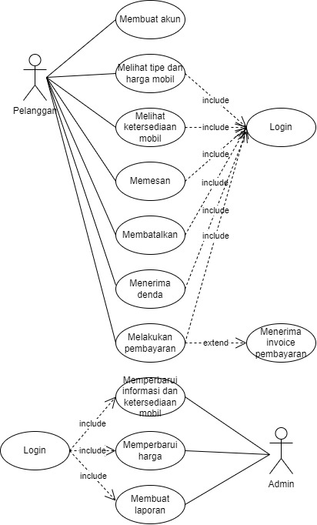
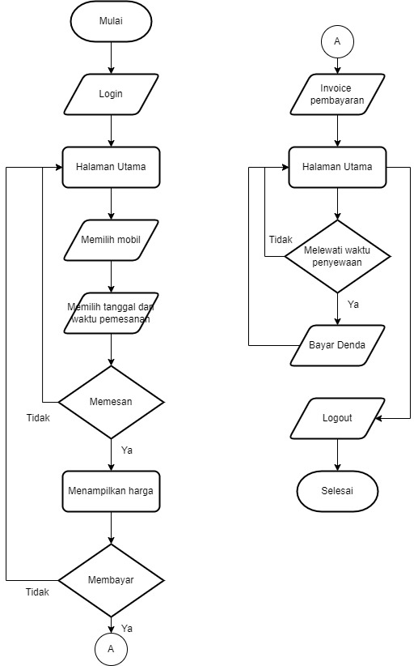
Usecase & Flowchart

Slide 7
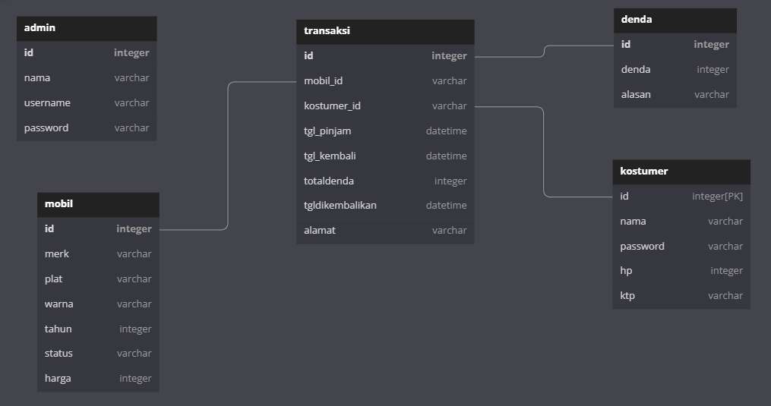
ERD

Slide 8
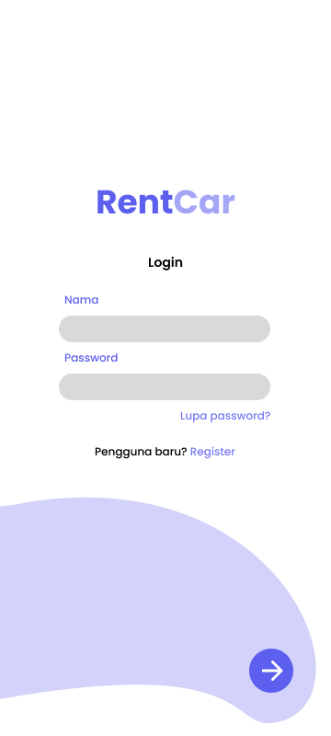
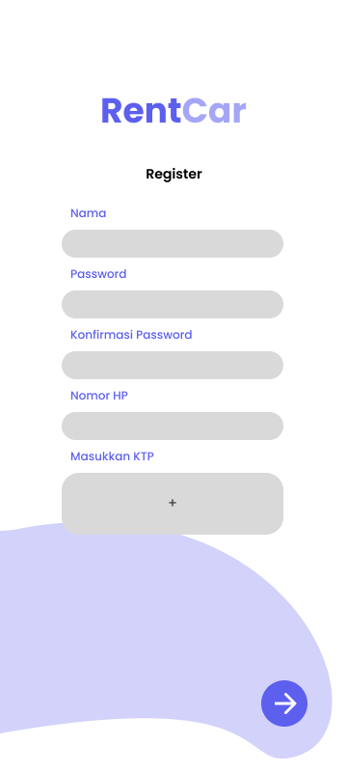
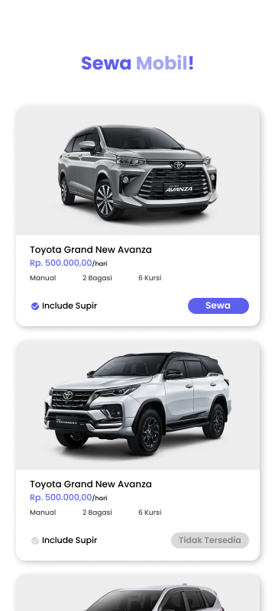
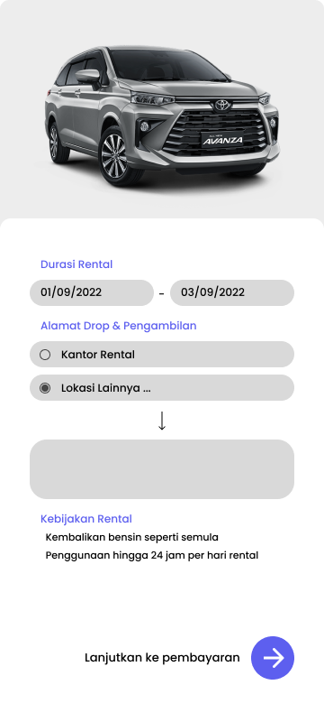
Mockup

Slide 9
Thanks

Slide 10
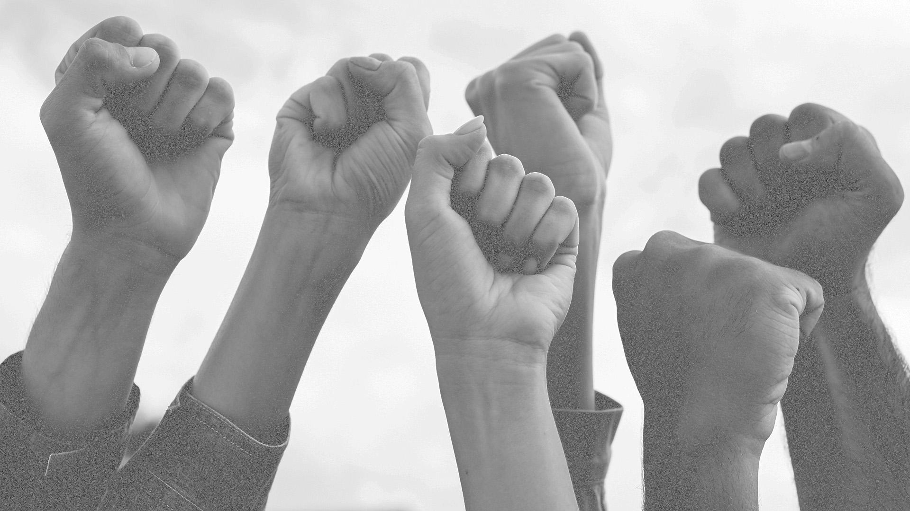
Steps
1.
Mercury
Mercury is the closest planet to the Sun
2.
Venus
Venus has a beautiful name, but it’s terribly hot
3.
Mars
Despite being red, Mars is actually a cold place

Slide 11
You could use three columns, why not?
Mars
Jupiter
Saturn
Despite being red, Mars is actually a very cold place
It’s a gas giant and the biggest planet in the Solar System
It’s a gas giant, composed mostly of hydrogen and helium

Slide 12

Customer engagement
70%
Jupiter it’s a gas giant and the biggest planet
Venus has a beautiful name, but it’s terribly hot
35%
Mercury is the smallest planet in the Solar System
50%

Slide 13

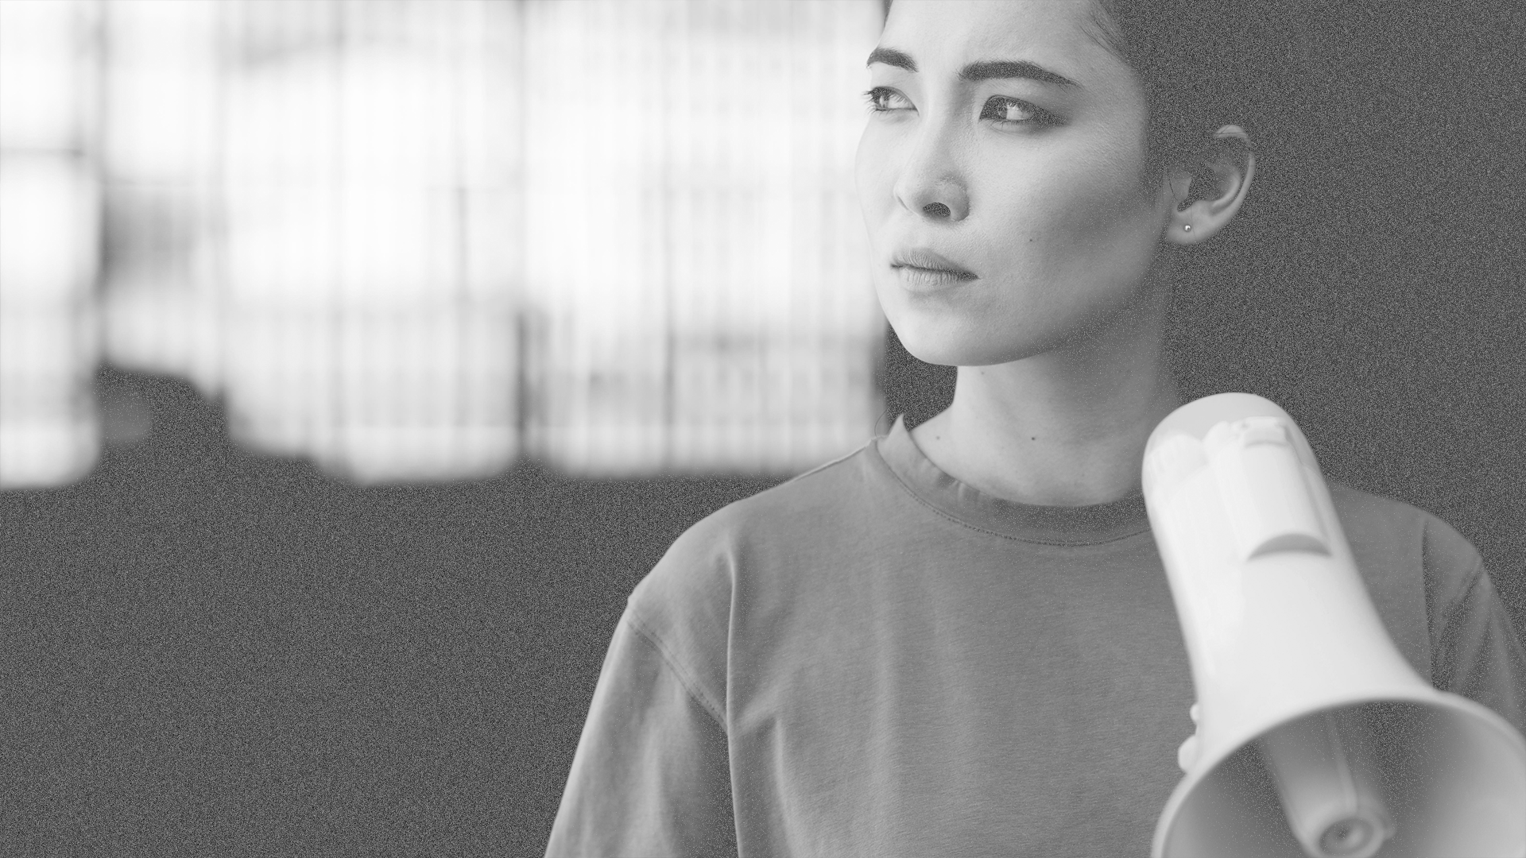
A picture always reinforces the concept
Images reveal large amounts of data, so remember: use an image instead of long texts

Slide 14
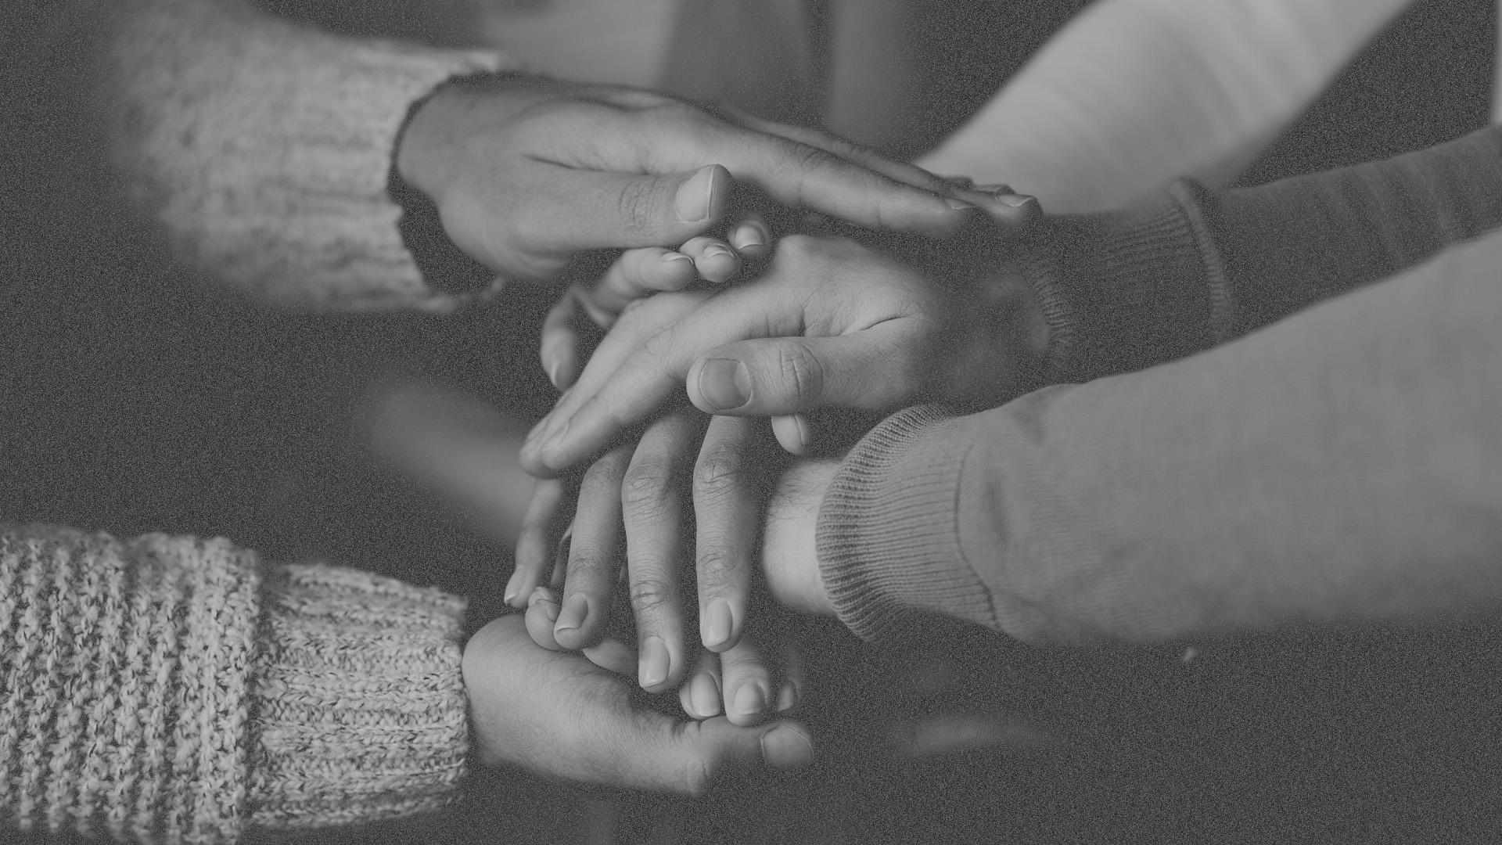
A picture is worth a thousand words

Slide 15
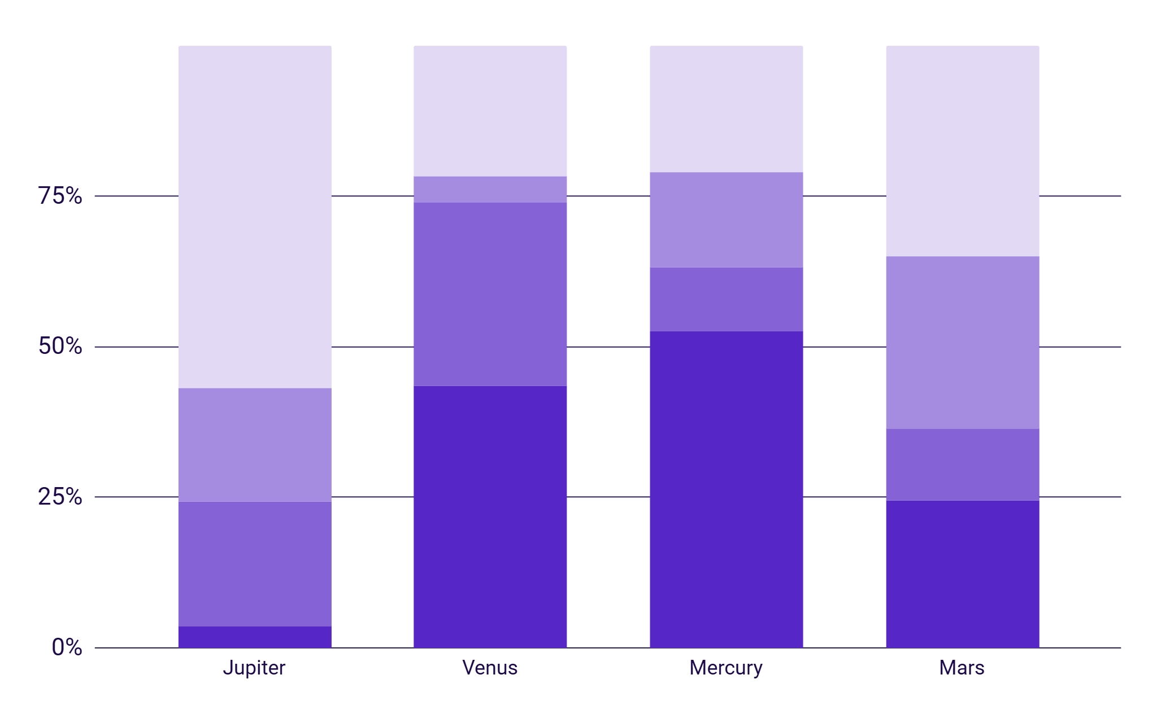
This is a graph
Density
Diameter
Mass
Water
To modify this graph, click on it, follow the link, change the data and paste the new graph here

Slide 16
Sometimes reviewing concepts is a good idea
Mercury
Venus
Mars
Mercury is the closest planet to the Sun
Has a beautiful name, but it’s terribly hot
Despite being red, Mars is a cold place
Jupiter
Saturn
Neptune
It’s the biggest planet in our Solar System
Saturn is the ringed one and a gas giant
Is the farthest planet from the Sun

Slide 17

Infographics make your idea understandable
Mercury
Saturn
A small planet
The ringed one
Mars
Venus
A cold place
Terribly hot
Jupiter
Neptune
A big planet
Very far away

Slide 18

...And the same goes for tables
 | Mass (earths) | Diameter (earths) | Surface gravity (earths)
Mercury | 0,06 | 0,38 | 0,38
Mars | 0,11 | 0,53 | 0,38
Saturn | 95,2 | 9,4 | 1,16

Slide 19

This is a map
Venus has a beautiful name, but it’s terribly hot
Mercury is the closest planet to the Sun
Despite being red, Mars is actually a cold place

Slide 20
A timeline always works well
Day 1
Day 3
Mercury is the closest planet to the Sun
Jupiter is the biggest planet of them all
Day 2
Day 4
Despite being red, Mars is a cold place
Venus has a beautiful name, but it’s very hot

Slide 21
Percentages
Mars
Mercury
Jupiter
Venus
The planet Mars is a very cold place
Mercury is close to the Sun
Jupiter is a very bright object
Venus has a beautiful name
70%
50%
25%
50%

Slide 22
Bars
60%
Mars
90%
Mercury
25%
Venus

Slide 23

4,498,300,000
Big numbers catch your audience’s attention

Slide 24
333,000.00
24h 37m 23s
386,000 km
earths is the Sun’s mass
is Jupiter’s rotation period
is the distance between Earth and the Moon

Slide 25
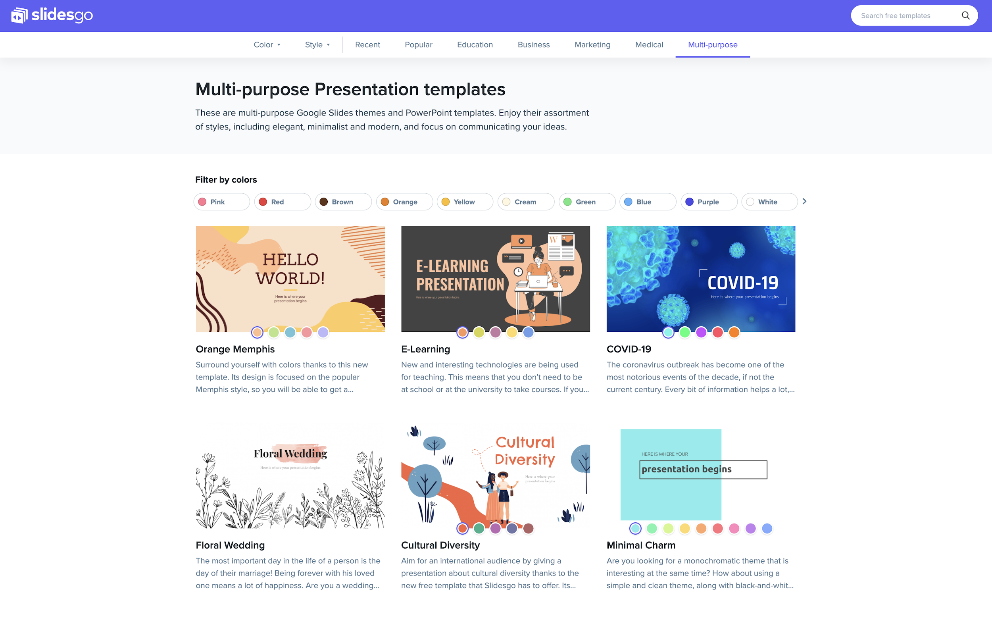
Desktop software
You can replace the image on the screen with your own work. Right-click on it and then choose "Replace image" so you can add yours

Slide 26
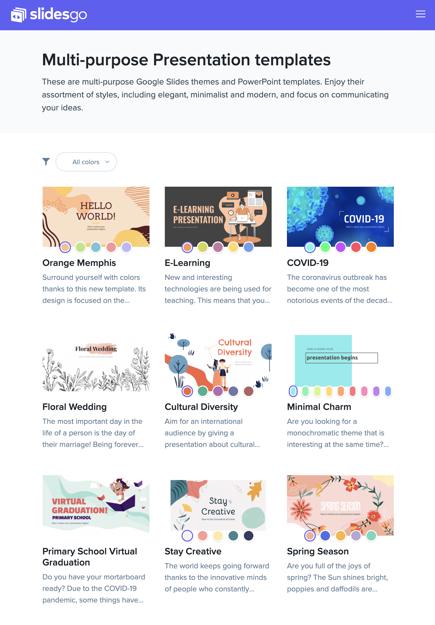
Tablet app
You can replace the image on the screen with your own work. Right-click on it and then choose "Replace image" so you can add yours

Slide 27
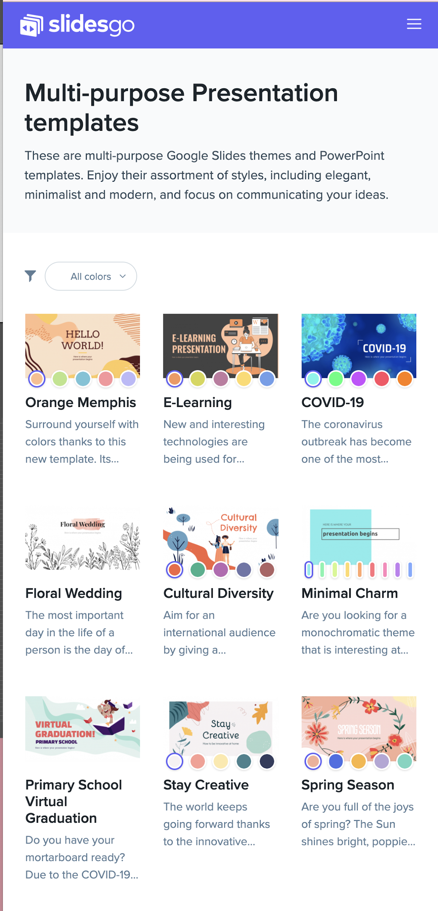
Mobile web
You can replace the image on the screen with your own work. Right-click on it and then choose "Replace image" so you can add yours

Slide 28
Our associates
Mercury
Mars
Saturn
It’s the closest planet to the Sun
Despite being red, Mars is cold
It’s the ringed one and a gas giant
Venus
Jupiter
Neptune
Venus has a beautiful name
Jupiter is the biggest planet
It’s very far away from Earth

Slide 29
Resources
Did you like the resources on this template? Get them for free at our other websites.
Photos
Group of positive people posing together
Asian woman protesting and holding megaphone
Group of young people posing together
Group of positive people gathering together
Group of protesters holding fists up
School and office supplies on red background
Colleagues preparing chart on paper over the desk in modern office
Vectors
Infographic element pack
Collection of colorful finance infographics
Digital device mockup set
Abstract background with gradient halftone effect
Halftone effect background gradient style
Black paint splashes abstract background
Purple dispersed backdrop

Slide 30
Instructions for use
In order to use this template, you must credit Slidesgo by keeping the Thanks slide.
You are allowed to:
- Modify this template.
- Use it for both personal and commercial projects.
You are not allowed to:
- Sublicense, sell or rent any of Slidesgo Content (or a modified version of Slidesgo Content).
- Distribute Slidesgo Content unless it has been expressly authorized by Slidesgo.
- Include Slidesgo Content in an online or offline database or file.
- Offer Slidesgo templates (or modified versions of Slidesgo templates) for download.
- Acquire the copyright of Slidesgo Content.
For more information about editing slides, please read our FAQs or visit Slidesgo School:
https://slidesgo.com/faqs and https://slidesgo.com/slidesgo-school

Slide 31
Instructions for use (premium users)
As a Premium user, you can use this template without attributing Slidesgo or keeping the "Thanks" slide.
You are allowed to:
Modify this template.
Use it for both personal and commercial purposes.
Hide or delete the “Thanks” slide and the mention to Slidesgo in the credits.
Share this template in an editable format with people who are not part of your team.
You are not allowed to:
Sublicense, sell or rent this Slidesgo Template (or a modified version of this Slidesgo Template).
Distribute this Slidesgo Template (or a modified version of this Slidesgo Template) or include it in a database or in any other product or service that offers downloadable images, icons or presentations that may be subject to distribution or resale.
Use any of the elements that are part of this Slidesgo Template in an isolated and separated way from this Template.
Register any of the elements that are part of this template as a trademark or logo, or register it as a work in an intellectual property registry or similar.
For more information about editing slides, please read our FAQs or visit Slidesgo School:
https://slidesgo.com/faqs and https://slidesgo.com/slidesgo-school

Slide 32
Fonts & colors used
This presentation has been made using the following fonts:
Montserrat
(https://fonts.google.com/specimen/Montserrat)
#6326EE
#FFFFFF
#000000
#A68CE1
#c5b4ef
#8765d7
#5626c6

Slide 33





Storyset
Create your Story with our illustrated concepts. Choose the style you like the most, edit its colors, pick the background and layers you want to show and bring them to life with the animator panel! It will boost your presentation. Check out How it Works.
Pana
Amico
Bro
Rafiki
Cuate

Slide 34
Use our editable graphic resources...
You can easily resize these resources without losing quality. To change the color, just ungroup the resource and click on the object you want to change. Then, click on the paint bucket and select the color you want. Group the resource again when you’re done.

Slide 37
JANUARY
FEBRUARY
MARCH
APRIL
MAY
JUNE
PHASE 1
Task 1
Task 2
PHASE 2
Task 1
Task 2
JANUARY
FEBRUARY
MARCH
APRIL
PHASE 1
Task 1
Task 2

Slide 40
...and our sets of editable icons
You can resize these icons without losing quality.
You can change the stroke and fill color; just select the icon and click on the paint bucket/pen.
In Google Slides, you can also use Flaticon’s extension, allowing you to customize and add even more icons.

Slide 41
Educational Icons
Medical Icons

Slide 42
Business Icons
Teamwork Icons

Slide 43
Help & Support Icons
Avatar Icons

Slide 44
Creative Process Icons
Performing Arts Icons

Slide 45
Nature Icons

Slide 46
SEO & Marketing Icons

Slide 47


